Slide 1
Richard Wittie
Homework week 15 Digital Microscopes
24 April 2018
Task 1: Gather items with interesting textures that you’d like to examine under the microscope. Be sure to collect both organic and non-organic items. Even if you are not sure about exactly what plant or rock or object you are looking at, bring a sample, such as the leaf or stalk or seedpod and we’ll try to identify them.
a. make a list of the items you gathered and examined under the microscope.
1) Baltic Amber
2) Copal
b. Try out some of the microscope settings and options such as various angles, using the light/not using the light, and different levels of magnification. Examine and photograph at least one item using different variations in light or magnification levels
c. identify some vocabulary words and/or concepts that students would need to know in order to understand what they are seeing under the microscope
Copal is semi-fossilized tree sap. It is semi-fossilized because unlike Amber it has not fully turned to stone. Copal is like harden resin. It can burn, melt, and can still have an odor of the sap if heated. Amber on the other hand is completely fossilized and is usually much older than copal. Amber is also more rare because the types of sap producing plants at the time and the same processes of fossilization can destroy or alter the sap preventing fossilization. Plant sap is a plants way of protecting a wound, because it is sticky bugs, reptiles, birds and other mater can get caught in it and covered with more sap. If the right conditions exist it can turn into copal or amber. Unfortunately the same drying process within the fossilization that mummifies insects and other items also destroys any DNA, so we need to look else ware for viable DNA for Jurassic Park.

Slide 2
identify at least two age-appropriate websites that would help students develop a deeper understanding of the vocabulary and/or concepts you listed in item b above
Eight Fun and Easy Microscope Experiments for Kids (elementary –HS. Good instructions for viewing items)
http://www.microscope-detective.com/microscope-experiments-for-kids.html#sthash.4neHeNRq.QhckpWbn.dpbs
History Poster of the microscope (middle – High school level)
https://www.nobelprize.org/educational/physics/microscopes/timeline/
Magnification and Resolution (HS. But has a good picture microscopic size that can be used else ware)
https://www.sciencelearn.org.nz/resources/495-magnification-and-resolution
Microscope fun facts
https://www.microscopeworld.com/t-the-history-of-the-microscope-infographic.aspx
Scientists retrieve 80-million-year-old dinosaur protein (High school level)
http://www.sciencemag.org/news/2017/01/scientists-retrieve-80-million-year-old-dinosaur-protein-milestone-paper

Slide 3
Task 2: Take at least 15 pictures of items under the microscope. You must include at least two items from at least three of the categories listed below (text/paper; fabrics/materials/textiles; human body; plants; non-plant outdoor items; everyday indoor objects). Save the images, making sure to name the files appropriately so that your peers in other groups can identify and examine them.
Questions to answer:
After viewing several items under the microscope, what did you see that intrigued or surprised you? Did you see anything you didn’t expect or predict?
I was surprised that the copal’s surface was completely full of tiny fractures making it difficult to focus on the insects within
b. Give two examples of how digital microscopes could enhance or extend student learning in ways that would not be possible without the use of this technology.
Using a digital microscope can reduce cost because everyone can see objects in real time on a screen compared to individual microscopes. Also everyone can see without having to adjust for vision or eyeglasses which could pose a issue. It also allows one to take instant pictures and videos. With some you can also transfer 3D images to a 3D printer
c. Give at least two examples of constraints or obstacles to using digital microscopes in the classroom.
1) the need to have a computer or monitor to view with, with the correct program and configuration to use the software
2) as with any microscope durability and reparability, being digital its MUCH harder to fix something if it breaks, and parts might not be available because its obsoleat

Slide 4

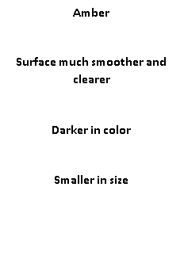
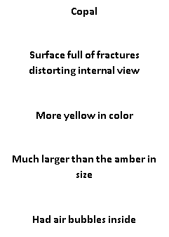
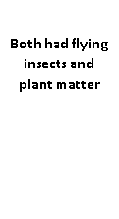
Task 3: After examining various items under the microscope from different angles using several different magnifications and light levels, think about ways you might classify the items. Develop categories for the items and briefly describe the criteria your group used for formulating the categories.
Insects in Copal and Amber

Slide 5
Task 4: Create a short slide show of images items you photographed during today’s digital microscope session (minimum of 15 slides). You can use powerpoint or one of the Web 2.0 tools available online for free such as Animoto or Prezi. Be prepared to share your slide show with the class next week.

Slide 6
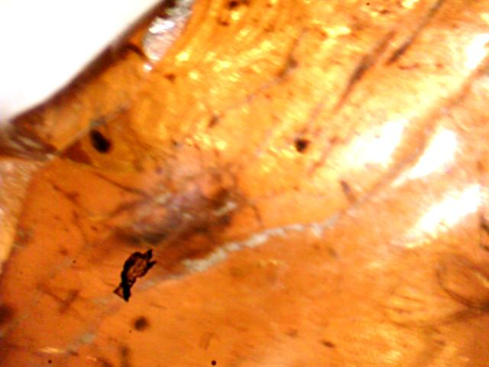
Insects and things in Amber and Copal
By Richard Wittie
4/24/2018

Slide 7
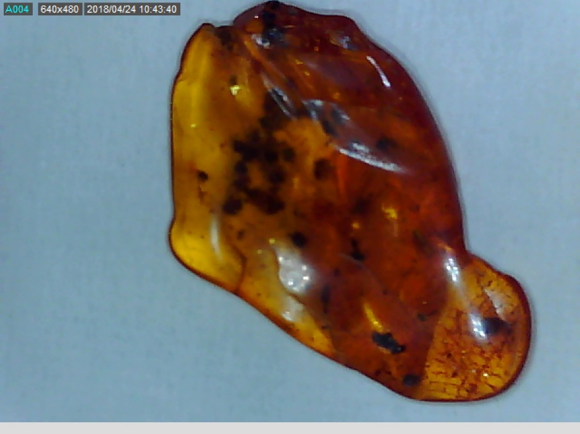
Baltic Amber with insects Eocene epoch
(44 million years old)

Slide 8
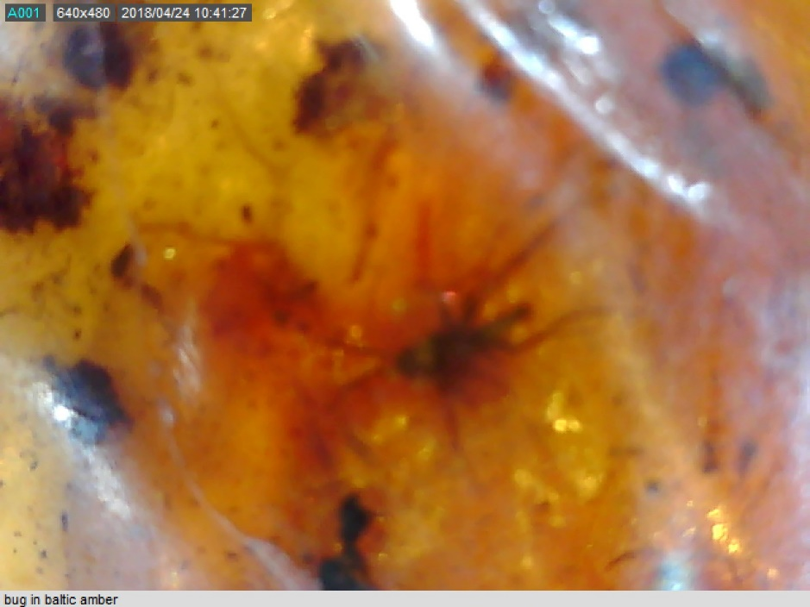

Slide 9
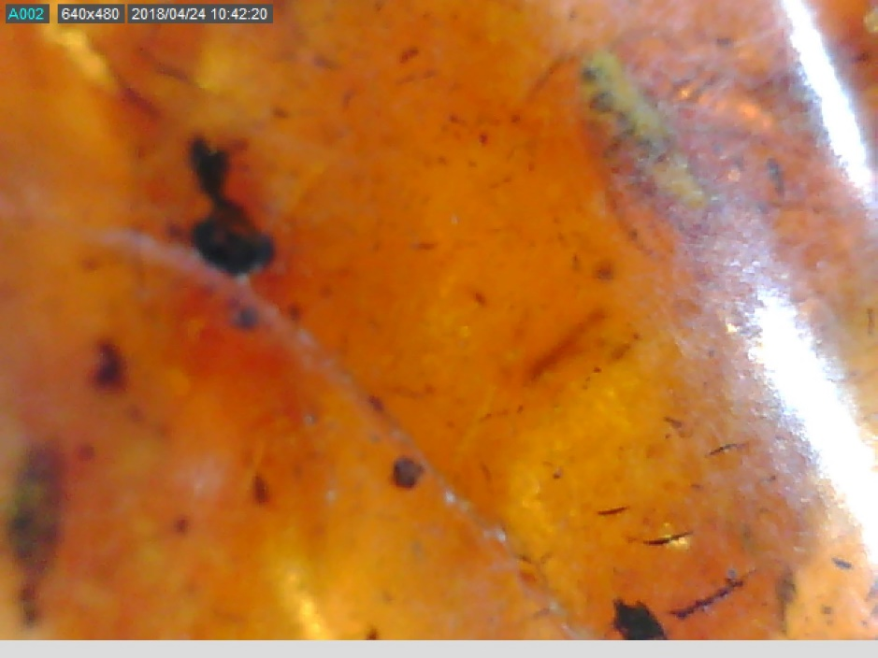
Possible fly in amber
(upper right)

Slide 10
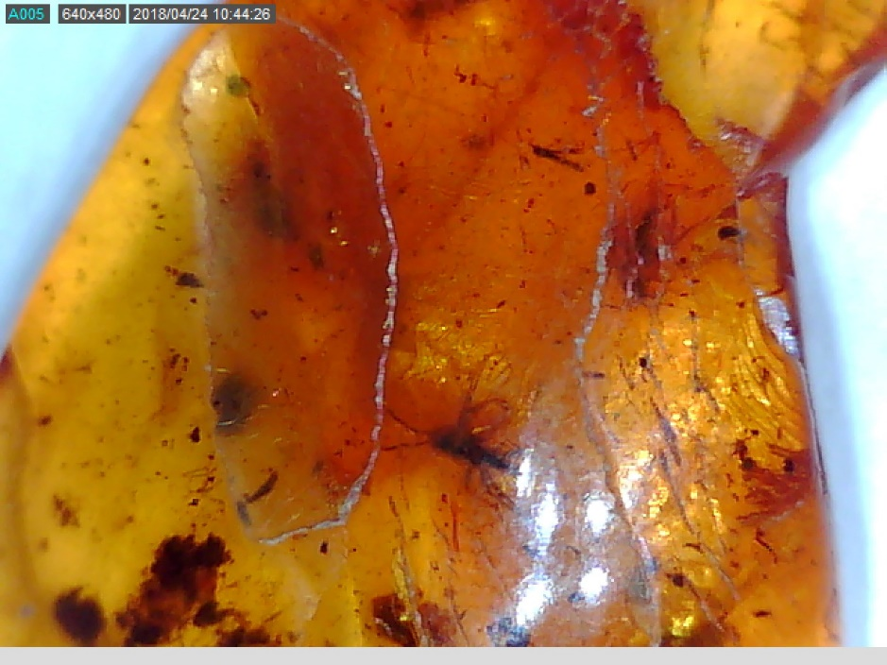
Possible knat in amber

Slide 11
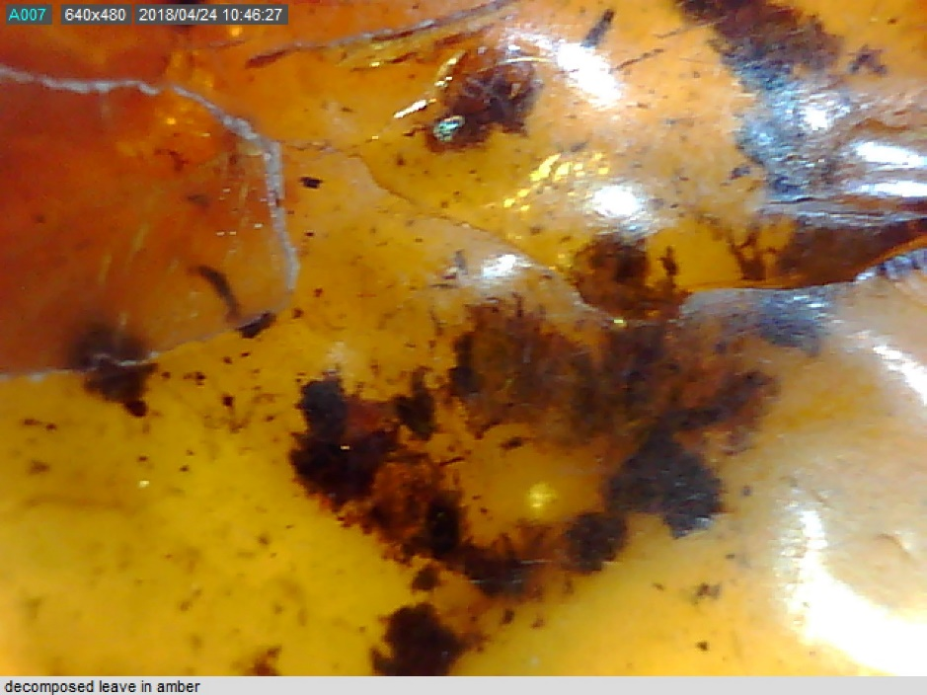

Slide 12
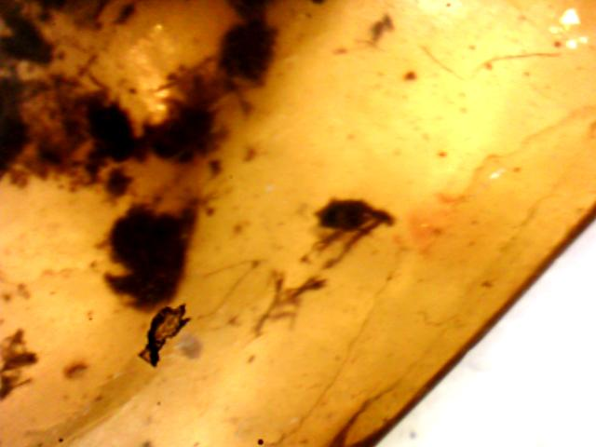
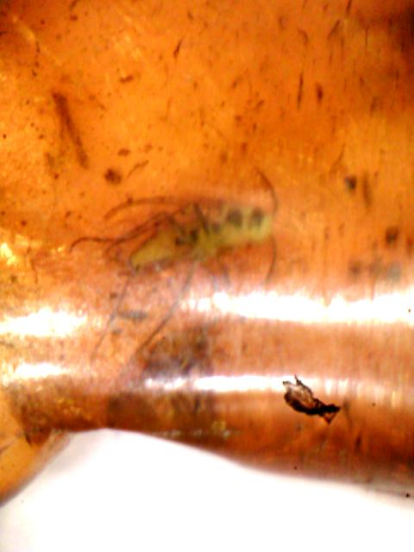
Possible fly?
Flee? Or moss?
Dirt on lens

Slide 13
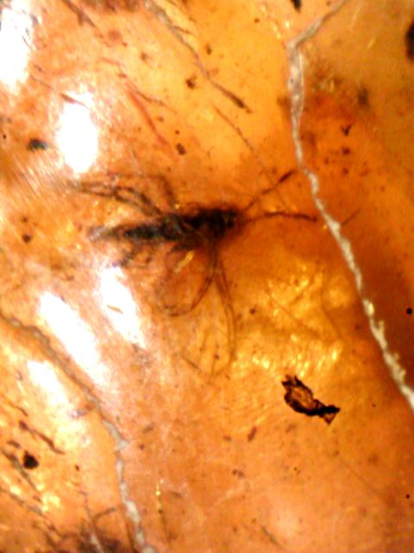
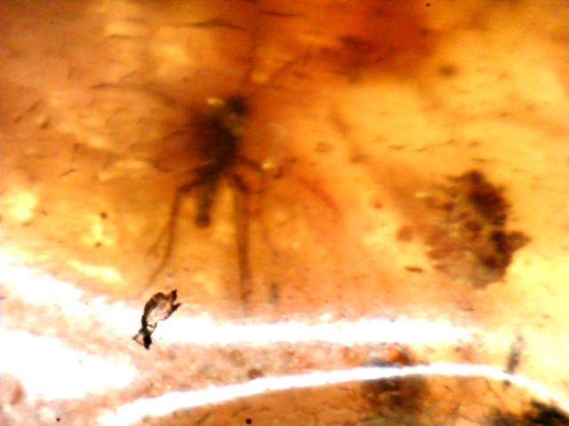
Top view bottom view

Slide 14
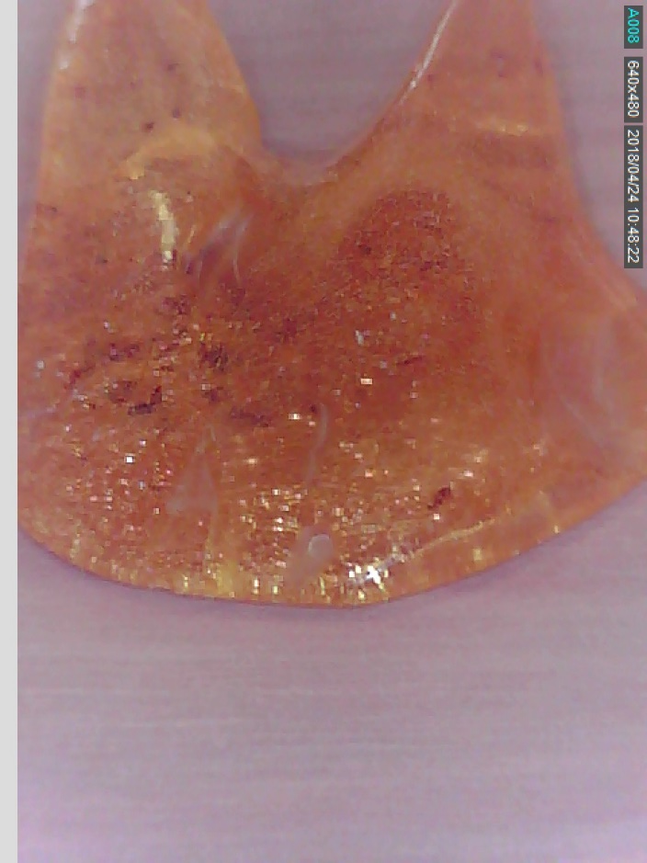
Madagascar Copal, Pleistocene in age
(2,588,000 to 11,700 years ago)

Slide 15
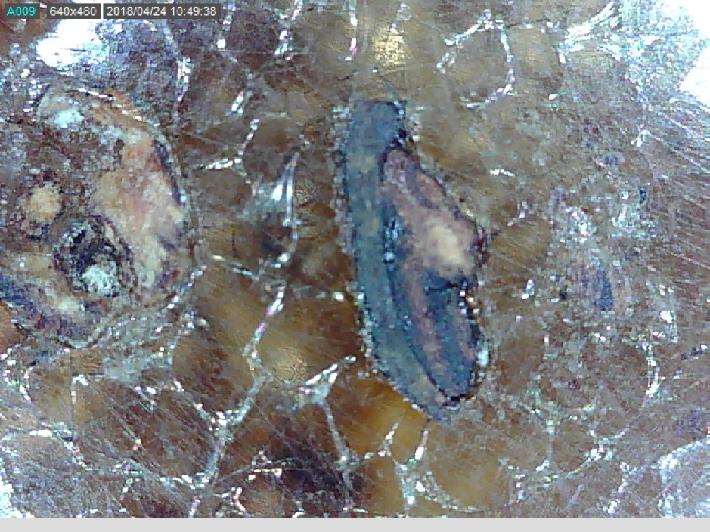
Surface cracks with decomposed seed on surface?

Slide 16
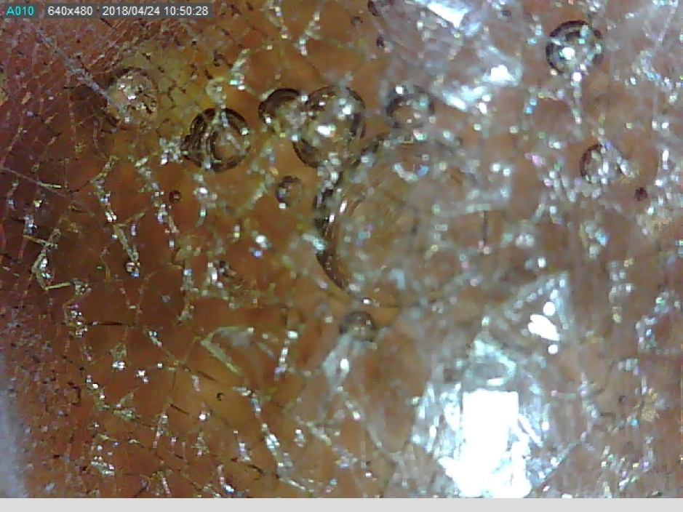
Air or water bubbles under the surface in copal

Slide 17
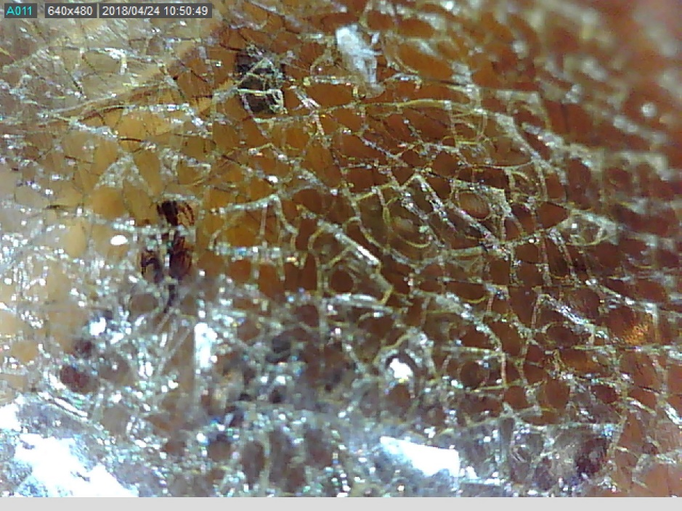
bug
Insect under surface cracks

Slide 18
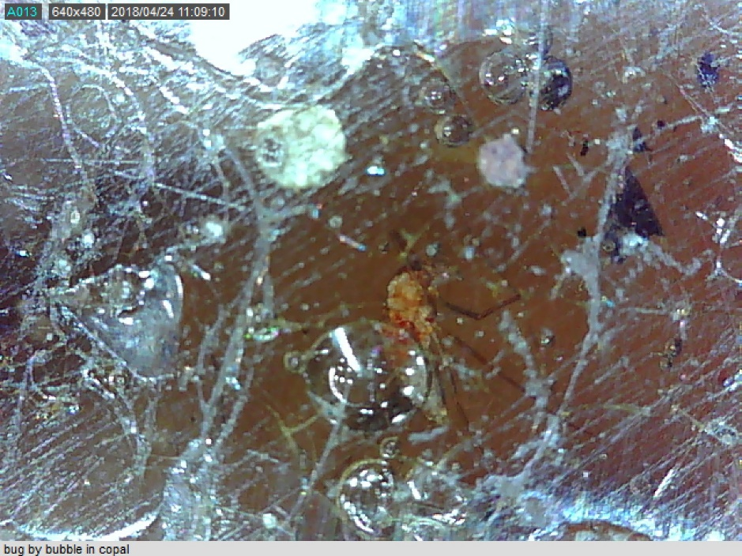
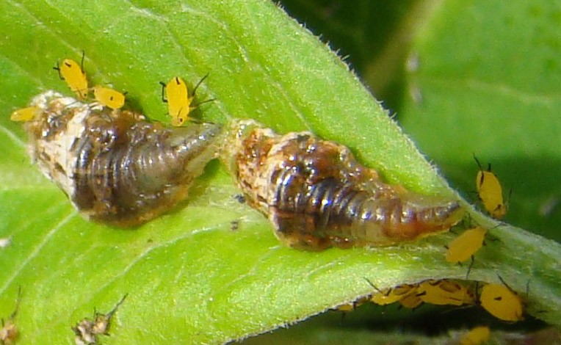
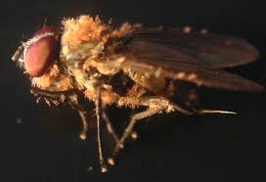
https://www.whatsthatbug.com/2009/07/29/syrphid-fly-larvae-eat-oleander-aphids/
Syrphid Fly Larvae eating
Oleander Aphids
https://microcosmos.foldscope.com/?p=16457
Entomophthora muscae fungi
on a fruit flies
Syrphid fly larvae eating bug or fungi infection
(this requires further investigation ☺ )

Slide 19
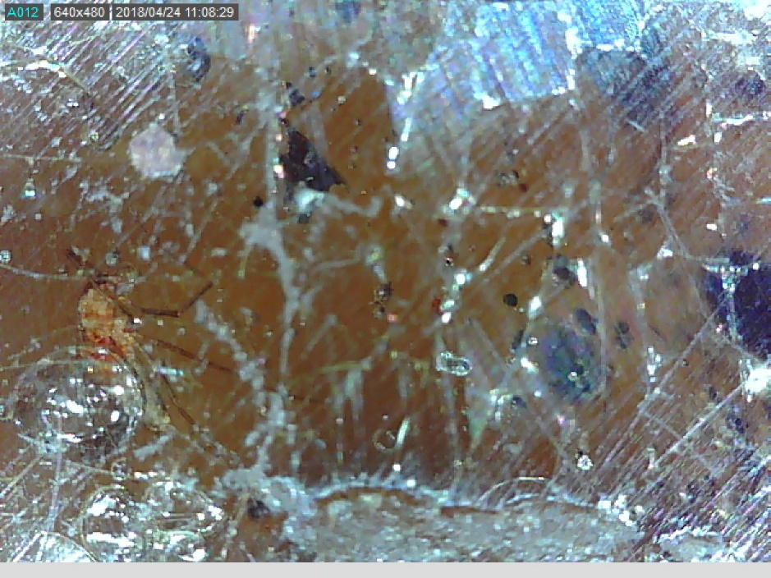
Different angle of infected bug By bubble

Slide 20
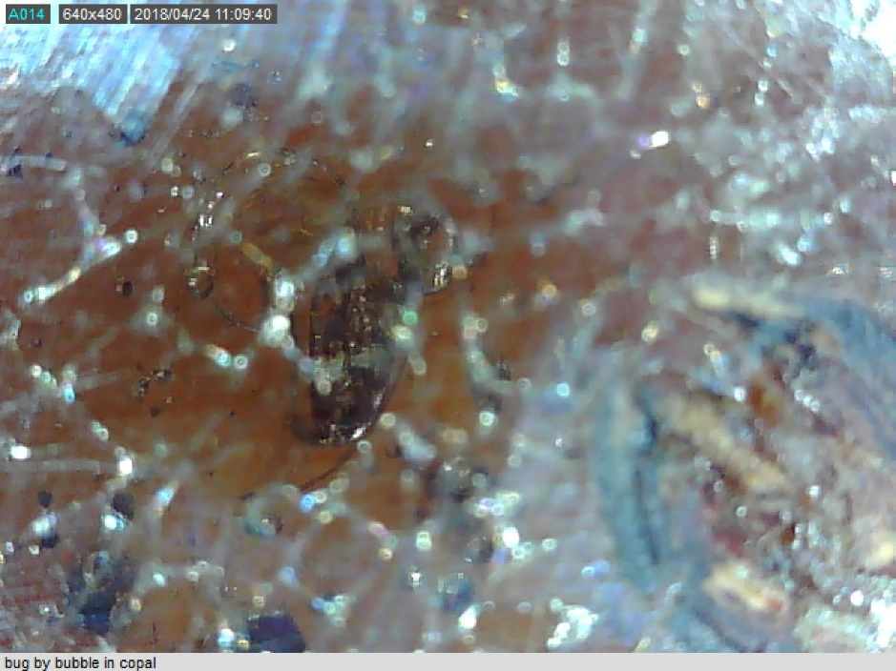
Surface cracks distorting image ☹

Slide 21
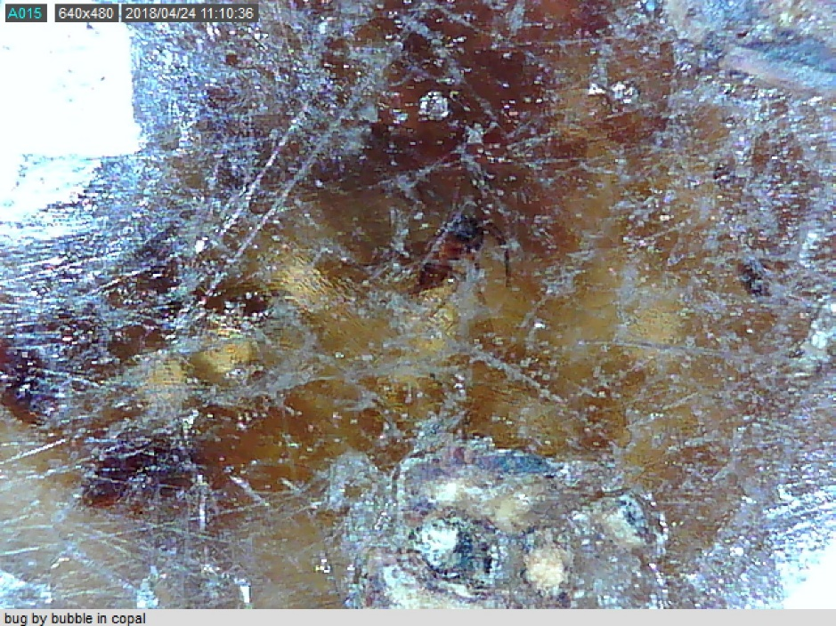

bug

Slide 22
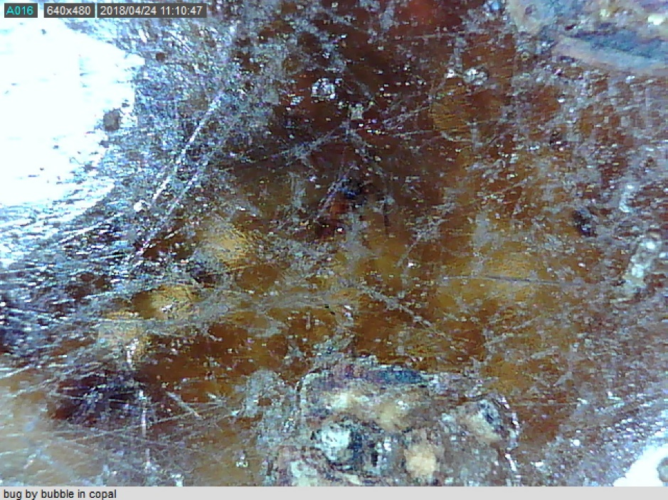
Same image but focused more to the surface

